Slide 1
Python
Fourth session

Slide 2
Many Lists
Creates many lists after the list operation

Slide 3
Numpy module
Numpy is extremely popular in python module
Installation can be done using pip
pip is a package management system used to install and manage software packages written in Python. ...Python 2.7.9 and later (on the python2 series), and Python 3.4 and later include pip (pip3 for Python 3)

Slide 4
Package installations
Three ways
PIP
Conda
GITbash

Slide 5
List vs Numpy
Less memory
Memory= size of each element * length of all
sys.getsizeof(5)*len(l) for lists
Array.size*array.itemsize
Convenient- mathematical operations can be done easily
fast

Slide 6
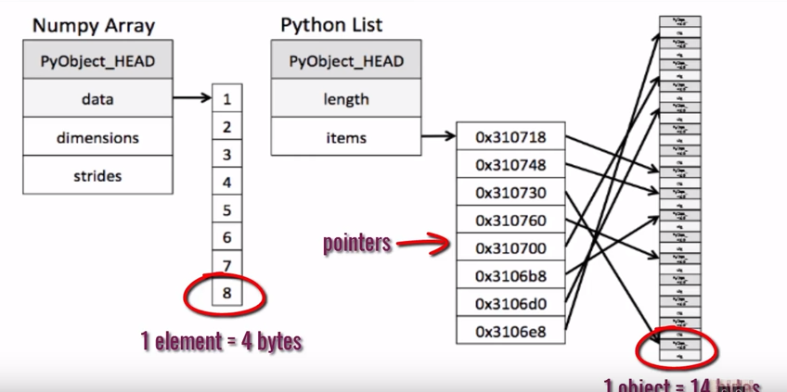

Slide 7
Basic array operations
dtype gives data type[a.dtype]
Size gives Len of array [a.size]
Shape of array [a.shape]
Np.zeros create array of zeros ex np.zeros((3,3))
Np.arange gives range of elements
np.linspace(1,5,10) linearly spaced numbers generation

Slide 8
A.reshape(2,3) reshapes the array
A.ravel() flattens the array
A.min() gives minimum value in an array
A.max() gives maximum value in an array
A.sum() adds all elements in an array
A.sum(axis=0) adds column elements
A.sum(axis=1) adds row elements
Np.sqrt(a) gives squareroot of all elements
Arithmetic

Slide 9
Slicing
Slicing of numpy works same as lists
Sicing can be done for multi dimensional array also
A=[6,7,8],[1,2,3],[4,5,6]
A[1,2]=3
A[0:2,2]=8,3

Slide 10
Stacking
Stacking combines the arrays either in horizontal way or in vertical way
A=np.arange(6).reshape(3,2)
b=np.arange(6,11).reshape(3,2)
Np.vstack(a,b) [vertical stacking]
Np.hstack(a,b)[horizontal stacking]

Slide 11
Splitting
Splitting splits the array into equal no of pieces we desire
A=np.arange(30).reshape(2,15)
Np.hsplit(a,n)
Np.vsplit(a,n)

Slide 12
Boolean arrays
Boolean gives true or false values in an array accordingly to the condition
A[1,2,3]
B=a>4;
[false,false,false]

Slide 13
Iterations
Nditer iteration is easily done with numpy
2 orders
C,A,K
F
Syntax = for i in np.nditer(z,order="K"):

